Slide 1

In-Lining
Concentrated Sales Process
Steps 1-5
Updated July 2023
Proprietary & Confidential. Not to be Disclosed or Used Outside of ITW

Slide 2
Introduction
The 5 Step Concentrated Sales Process (CSP):
  Is an ITW FEG-wide method based on best practice
  Aligns the sales process for Key Account Business
  Drives ITW FEG sales excellence
  Increases market share
  Provides best in class customer experience
The process contains 5 Steps:
  Segmentation & Customer Analysis
  Mapping the Customer
  Customize the Value Proposition
  Setting the Plan to Win
  Deploy & Follow Up
These steps are:
  Sequential but information will be added and updated constantly
  an iterative process where information is transferred from step to step.
Each individual step contains its own sub-steps. These sub-steps are described within this playbook on the following pages with flowcharts, explanations, watch-outs, checklists and dedicated tools.
2

Slide 3
Concentrated Sales Process
Detail with Sub-Steps
1. Segmentation & Customer Analysis
2. Mapping the Customer
3. Customize the Value Proposition
4. Setting the Plan to Win
5. Deploy & Follow Up
1.1 Identify
your ’80’ target sub-segments based on FTB data, external data for Market Growth Areas and product match-making (type of products we are selling to ’80’ accounts)
Develop criteria of a ‘good’ prospect in the market.
1.2 Evaluate
and filter the most attractive opportunities based on business criteria and thresholds
1.3 Prioritize
80’ customers/opportunities that will enable maximum focus on high potential opportunities (business impact, time/effort & resources/investments to implement)
2.1 Identify Contacts & Classification with different Roles
Sum up findings out of STEP 1 and set up timeline for the whole STEP 2. Identify and include all customer in a list.
2.2 Profiling of the Customer Network
Develop customer contact profile and assign customer classification. Connect customer contacts with ITW representatives.
2.3 Understand Customer Procurement Process
Identify customer Procurement process
2.4 80/20 Focusing
Selection of 80 customer contacts
2.5 Relationship-Management Actions
Set up an Action Plan for identified Key Contacts
3.1 Define customer’s needs, pain points & opportunities
3.2 Determine Product/Service Strategy
  Does current product or customized solution meet the needs or require an enhancement?
  Risk Assessment
3.3 Customize our Value Proposition
  Uptime
  Quantify lost sales,
  Impact to retailer
  Inventory
  Financial impact/Payback scenario
  Efficiency
  Safety
4.1 Product Testing
Understand, engage in, and execute the product testing phase
4.2 Finalization of Specification
Completely align w/ our customer on physical and performance specifications
4.3 Establish Pricing
4.4 Documented Commitment to Purchase
4.5 Deployment Strategy
Effectively execute a deployment strategy, and facilitate a transition to Step 5
5.1 Project Deployment
    Project Management
    Operations
    Supply
    Aftersales
5.2 Follow Up
    Inside – Out
    Quantitative Performance Tracking
    Financial validation
    Outside – In
    Qualitative Performance Tracking
    Internal & External Feedback
    Leverage Performance with Customer
NAM Led
SDM Led
NAM Led
Responsible (R) | Accountable (A) | Consulted (C) | Informed (I)
The “doer” | Position with Yes/No authority Responsible person(s) are accountable to this person | Stakeholder or subject matter expert who are not directly involved with carrying out the task, but who are consulted | Person who is notified once a final decision has been made or after implementation takes place
Proprietary & Confidential. Not to be Disclosed or Used Outside of ITW
3

Slide 4
Concentrated Sales Process
Deeper Explanation
1. Segmentation & Customer Analysis
2. Mapping the Customer
3. Customize the Value Proposition
4. Setting the Plan to Win
5. Deploy & Follow Up
Account Opportunities are Prioritized
Assess total FEG share
Assess account growth opportunity
Does the account that values ITW innovation
Is it a good fit for ITW?
Setting the Stage
What is the depth of the Map?
Who are the key influencers and decision makers for various FEG opportunities?
Building ITW’s Reputation as the Experts
Spend time in the facility to identify pain points/needs through Strategic Questions and Listening.
Engagement of resources from product line to build value.
Product Feature Benefit
Spend time in the facility to validate the solution.
Make adjustments to the product to ensure performance.
Prepare for the rollout.
Close the Sale
Deliver solutions to match commitment.
Obtain customer feedback on performance.
Maximize account penetration (corporate and franchised).
NAM Led
SDM Led
NAM Led
Proprietary & Confidential. Not to be Disclosed or Used Outside of ITW
4

Slide 5
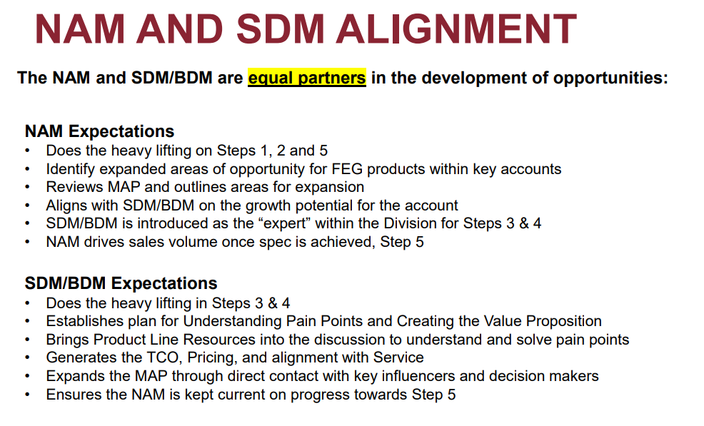
Concentrated Sales Process
Proprietary & Confidential. Not to be Disclosed or Used Outside of ITW
5

Slide 6
Concentrated Sales Process – Step 1
Concentrated / Key / Development Accounts
1. Segmentation & Customer Analysis
2. Mapping the Customer
3. Customize the Value Proposition
4. Setting the Plan to Win
5. Deploy & Follow Up
1.1 Identify
your ’80’ target sub-segments based on FTB data, external data for Market Growth Areas and product match-making (type of products we are selling to ’80’ accounts)
Develop criteria of a ‘good’ prospect in the market.
1.2 Evaluate
and filter the most attractive opportunities based on business criteria and thresholds
1.3 Prioritize
80’ customers/opportunities that will enable maximum focus on high potential opportunities (business impact, time/effort & resources/investments to implement)
2.1 Identify Contacts & Classification with different Roles
Sum up findings out of STEP 1 and set up timeline for the whole STEP 2. Identify and include all customer in a list.
2.2 Profiling of the Customer Network
Develop customer contact profile and assign customer classification. Connect customer contacts with ITW representatives.
2.3 Understand Customer Procurement Process
Identify customer Procurement process
2.4 80/20 Focusing
Selection of 80 customer contacts
2.5 Relationship-Management Actions
Set up an Action Plan for identified Key Contacts
3.1 Define customer’s needs, pain points & opportunities
3.2 Determine Product/Service Strategy
  Does current product or customized solution meet the needs or require an enhancement?
  Risk Assessment
3.3 Customize our Value Proposition
  Uptime
  Quantify lost sales,
  Impact to retailer
  Inventory
  Financial impact/Payback scenario
  Efficiency
  Safety
4.1 Product Testing
Understand, engage in, and execute the product testing phase
4.2 Finalization of Specification
Completely align w/ our customer on physical and performance specifications
4.3 Establish Pricing
4.4 Documented Commitment to Purchase
4.5 Deployment Strategy
Effectively execute a deployment strategy, and facilitate a transition to Step 5
5.1 Project Deployment
    Project Management
    Operations
    Supply
    Aftersales
5.2 Follow Up
    Inside – Out
    Quantitative Performance Tracking
    Financial validation
    Outside – In
    Qualitative Performance Tracking
    Internal & External Feedback
    Leverage Performance with Customer
NAM Led
Proprietary & Confidential. Not to be Disclosed or Used Outside of ITW
6

Slide 7
STEP 1: WHAT / WHY / DESIRED OUTCOMES
What
Why
Desired Outcomes
Step 1.1
Identify your ’80’ target sub-segments based on FTB data, external data for Market Growth Areas and product match-making (type of products we are selling to ’80’ accounts)
Develop criteria of a ‘good’ prospect in the market. (focus on a set of ’80’ criteria to keep it simple)
Step 1.2
Evaluate and filter the most attractive opportunities based on business criteria and thresholds
Step 1.3
Prioritize ’80’ customers/opportunities that will enable maximum focus on high potential opportunities (business impact, time/effort & resources/investments to implement)
It is important to make an initial selection of market and internal data – clearly defining internal targets and prioritizations.
We need to understand how to evaluate the customer & related opportunities – focusing on the key data.
Focuses on relevant criteria which reflect besides core indicators a good match in line with our strength.
All data and inputs needed to provide clarity for proceeding to next step, Mapping the Customer.
Prioritized target customer listing.
Initial opportunity details + investment + risks + watch outs = Efforts vs. Impact.
Pipeline generation for growth in “like” customers/ segments.
Watchlist of good fit but not now for further investigation.
Develop/ use tools – in order to help the analysis.
Proprietary & Confidential. Not to be Disclosed or Used Outside of ITW
7

Slide 8
STEP 1.1: CHECKLIST
Activity | Responsible | Accountable | Consulted | Informed | TOOL / Best Practice
Pre-Requisites - Strategic FTB Analysis | NAM / BUM / VP/GM | NAM | SDM / SERVICE | GP | FtB Playbook - Step 2
Make sure you have performed Step 1 & Step 2 of Front to Back (80 Products & Customer Segments).
Segment the business to target ’80’ opportunities and defocus resources on ’20’: Segment customer process/applications Segment your division’s products/offerings
Gather outside-in information in order to verify your data
Define the target segment(s) for further analysis
A - Identify Customers - Product Matchmaking | NAM / BUM / PLM | NAM | SDM / SERVICE | n/a
Follow process in product match-making appendix
Segment the ’80’ products/offerings that we are selling to ‘80’ accounts identifying commonalities (Lever 2 items)
Re-group them back into a list of fewer 80 Products
B - Identify Customers - Customer Listings | NAM / BUM / PLM | NAM | SDM / SERVICE | n/a
Identify different segmentation factors/attributes for your 80 Customers
Use this new segmentation to create a list of customers within identified sub- segments
Proprietary & Confidential. Not to be Disclosed or Used Outside of ITW
8

Slide 9
STEP 1.2: CHECKLIST
Activity | Responsible | Accountable | Consulted | Informed | TOOL / Best Practice
A – Evaluate | NAM / SDM | NAM | SERVICE | VP / GM
Once grouped properly, you could assess the attractiveness of both ’80’ products & ’80’ customers (sub-segments) in order to obtain a “go forward” list of ’80’ opportunities (see example set of ’80’ criteria for a “good prospect in the market”)
Filter the list according to these ’80’ criteria and re-group them into fewer 80 customer opportunities
B - Evaluate - Direct Criteria | NAM / SDM | NAM | SERVICE | VP/GM
Current install base: How many machines / type (revenue potential)? How old are the machines / products? What is the ITW Share?
Wallet & VM% Potential: Potential revenue & VM% that can be realized What could be the full business (ITW/FEG) potential for this opportunity with this customer?
Satisfaction with current solutions: Is the customer satisfied with the current solutions & providers? What are the incumbents strengths / weaknesses?
Predictive value proposition strength: What is the net value increase to end users if we succeed? (Benefits - costs & investment) How does this align with the customer’s values? Do we have barriers to entry (opportunistic)?
C - Evaluate - Related Criteria | NAM / SDM | NAM | SERVICE | VP/GM
Opportunity for others: Analyze the FEG pull-through potential: Are there related opportunities? (i.e. in terms of installation, maintenance, software etc.)
Strategic Fit: How well does this align with the BU's overall strategy? Is it included in AP / LRP plans?
Expansion: Is a global / multi-regional or regional customer? Where could this solution be rolled out to? Could other customers benefit from this solution?
Proprietary & Confidential. Not to be Disclosed or Used Outside of ITW
9
Notes:
Checklist as a summary of Step 1:
Identify sub-segments profile criteria
Identify sub-segments requirements
Identify product strengths & fit to requirements
Evaluate competitive landscape & opportunities
Evaluate opportunity size
Evaluate resource/time required for potential sales project
Evaluate potential project risks & drawbacks
Create sales project team and leader

Slide 10
STEP 1.3: CHECKLIST
Activity | Responsible | Accountable | Consulted | Informed | TOOL / Best Practice
A – Prioritize | NAM / SDAM | NAM | Service / Marketing / Finance | GP
Hold the prioritization gate review
Build a list of opportunistic targets & quick wins, according to short, mid, long term action plans & related results
Re-group your list into fewer and proper ’80’ potential sales projects opportunities
Make sure the final list of ’80’ opportunities will enable you to maximize your resources/investment towards highest growth potential opportunities in a optimum effective way
Proprietary & Confidential. Not to be Disclosed or Used Outside of ITW
10
Notes:
Checklist as a summary of Step 1:
Identify sub-segments profile criteria
Identify sub-segments requirements
Identify product strengths & fit to requirements
Evaluate competitive landscape & opportunities
Evaluate opportunity size
Evaluate resource/time required for potential sales project
Evaluate potential project risks & drawbacks
Create sales project team and leader

Slide 11
STEP 1: LEARNINGS
Responsible | Accountable | Consulted | Informed
NAM / SDM NAM / SDM NAM | NAM NAM NAM | SERVICE SERVICE SERVICE / MARKETING / FINANCE | n/a VP/GM GP
Step 1.1 Identify
Service & Installations (if required) should be involved from the start. It is most important to gather/create information as soon as possible for service/install on customized complex products – use past customer interactions to help
Presumed market knowledge vs data verification: The clearer the understanding at this point, the less wasted time and effort.
Step 1.2 Evaluate
Long standing relationships are key to customer information access (Relationship is KEY, when there isn’t a well entrenched relationship we are lacking in response/understanding).
Need better FEG assessment of conflicted product line & service priorities.
Ensure Sales & Service coordination in criteria development.
Do not lose time chasing a wrong product fit. Vetted options should we not have a product fit…
Strength of brand does not guarantee us being in the competitive conversation.
Need to position ourselves to be in the conversation from the start.
Step 1.3 Prioritize
Scalability - If we have more than one big prospect going on at a time – focus on the ’80’ and prioritize resource
General
Chasing customer spec instead of driving spec.
When current customer relationship is not existing, we tend to use broad offering approach
Proprietary & Confidential. Not to be Disclosed or Used Outside of ITW
11

Slide 12
STEP 1 Key Takeaways
Building the bridge from FTB to Sales excellence
Getting clarity of our best growth opportunities and where to spend our time
Just because the customer has a lot of locations doesn’t mean they are a good fit for us to pursue.
Allows best use of resources, not spending too much time on customers with low potential or no fit
Proprietary & Confidential. Not to be Disclosed or Used Outside of ITW
12

Slide 13
Concentrated Sales Process – Step 2
Concentrated / Key / Development Accounts
1. Segmentation & Customer Analysis
2. Mapping the Customer
3. Customize the Value Proposition
4. Setting the Plan to Win
5. Deploy & Follow Up
1.1 Identify
your ’80’ target sub-segments based on FTB data, external data for Market Growth Areas and product match-making (type of products we are selling to ’80’ accounts)
Develop criteria of a ‘good’ prospect in the market.
1.2 Evaluate
and filter the most attractive opportunities based on business criteria and thresholds
1.3 Prioritize
80’ customers/opportunities that will enable maximum focus on high potential opportunities (business impact, time/effort & resources/investments to implement)
2.1 Identify Contacts & Classification with different Roles
Sum up findings out of STEP 1 and set up timeline for the whole STEP 2. Identify and include all customer in a list.
2.2 Profiling of the Customer Network
Develop customer contact profile and assign customer classification. Connect customer contacts with ITW representatives.
2.3 Understand Customer Procurement Process
Identify customer Procurement process
2.4 80/20 Focusing
Selection of 80 customer contacts
2.5 Relationship-Management Actions
Set up an Action Plan for identified Key Contacts
3.1 Define customer’s needs, pain points & opportunities
3.2 Determine Product/Service Strategy
  Does current product or customized solution meet the needs or require an enhancement?
  Risk Assessment
3.3 Customize our Value Proposition
  Uptime
  Quantify lost sales,
  Impact to retailer
  Inventory
  Financial impact/Payback scenario
  Efficiency
  Safety
Key Points:
In simple terms:
Be sure to know all players, and where the influence lies
Be sure to understand their buying process
Develop high-quality targeted relationship strategies
4.1 Product Testing
Understand, engage in, and execute the product testing phase
4.2 Finalization of Specification
Completely align w/ our customer on physical and performance specifications
4.3 Establish Pricing
4.4 Documented Commitment to Purchase
4.5 Deployment Strategy
Effectively execute a deployment strategy, and facilitate a transition to Step 5
5.1 Project Deployment
    Project Management
    Operations
    Supply
    Aftersales
5.2 Follow Up
    Inside – Out
    Quantitative Performance Tracking
    Financial validation
    Outside – In
    Qualitative Performance Tracking
    Internal & External Feedback
    Leverage Performance with Customer
NAM Led
Proprietary & Confidential. Not to be Disclosed or Used Outside of ITW
13

Slide 14
STEP 2: WHAT / WHY / DESIRED OUTCOMES
What
Why
Desired Outcomes
Step 2.1
Identify Contacts & Classification with different Roles
Sum up findings out of STEP 1 and set up timeline for the whole STEP 2. Identify and include all customer in a list.
Step 2.2
Profiling of the Customer Network
Develop customer contact profile and assign customer classification. Connect customer contacts with ITW representatives.
Step 2.3
Understand Customer Procurement Process
Identify customer Procurement process
Step 2.4
80/20 Focusing
Selection of 80 customer contacts
Step 2.5
Relationship-Management Actions
Set up an Action Plan for identified Key Contacts
To provide a process for mapping the customer and identifying the important contacts based on a 80/20 approach.
To ensure that we have identified all the contacts and the relevant network (no blind spots).
Method to set up a valid relation ship to key people at focus customers.
Enable (FEG) stakeholders to focus on the relevant contacts in the organization to drive growth.
Give everyone clear view on customer decision makers and influencers. Only spending time with the right people and focusing on the “80” opportunity.
Useful tool to support customer map through complete 5 Step process and reach FEG targets in concentrated markets.
Key Points (emphasis on “Why”):
Blind spots are real – Mapping minimizes risk
Layered relationships between the client and ITW help to maximize potential for best partnership
Proprietary & Confidential. Not to be Disclosed or Used Outside of ITW
14

Slide 15
STEP 2: OVERVIEW
GOALS
Step 2.1
IDENTIFY CONTACTS
Step 2.2
PROFILING OF THE CUSTOMER NETWORK
Step 2.3
UNDERSTAND PROCUREMENT PROCESS
Step 2.4
80/20 FOCUSING
Step 2.5
RELATIONSHIP MANAGEMENT ACTIONS
Sum up findings out of STEP 1
Set up Timeline for whole STEP 2
Identify and include all customer contacts in a list
Document what you know and what you don’t know
Identify customer Organization Chart
Connect customer contacts with ITW representatives
Outline customer Procurement Process
Transfer information regarding Decision Makers & Influencers to Full Contact List
Reprioritize customer if necessary
80/20 Focusing for listed & classified contacts
Include 80 customer contacts in Relationship Management Tool
Analyze Bubble Chart
Set up an appropriate Action Plan (Defined Actions: who, what, when, where)
Final vetting out which customer is ready to go forward with to STEP 3
KEY STEPS
List of identified contacts & profiles
Customer Network Chart with ITW matches
Customer Procurement Process Map with accountable contacts
Selection of 80 customer contacts
Relationship Management Tool & Action Plan
DELIVERABLES
Proprietary & Confidential. Not to be Disclosed or Used Outside of ITW
15
Notes:
Key Points:
Focus on the deliverables, not the steps.
2.2 has a tool, for the rest the Account Manager is accountable.

Slide 16
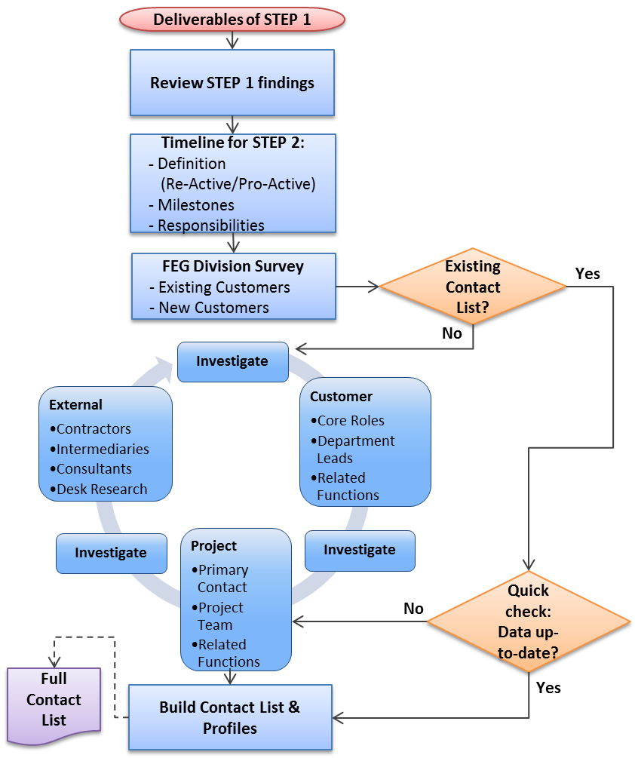
STEP 2.1: IDENTIFY CONTACTS
Step 2.1
IDENTIFY CONTACTS
Key Steps
Applies to both Re-Active & Pro-Active approaches
→ Same Flow but different Timeline
1. Review STEP 1 findings to use already existing information
2. Definition of the Milestones to identify the right contacts
3. Gather contact information from relevant sources
(Survey/Investigation)
4. Build up Contact List and include all relevant contact
information
Key Points:
Don’t limit the number of contacts at this point
Just because a customer is an existing customer, don’t assume that you have a good list. This complacency will result in gaps. Always be updating!
Proprietary & Confidential. Not to be Disclosed or Used Outside of ITW
16
Notes:
Key Points:
Make sure audience is clear with the flow.
Just because a customer is an existing customer doesn’t mean you’ve got a good list. In fact, these are the ones where there are most likely to be gaps. Check again!

Slide 17
STEP 2.1: CHECKLIST
Activity | Responsible | Accountable | Consulted | Informed | TOOL / Best Practice
List of ALL the identified Contacts & Profiles |  |  |  |  | STEP 2 Flowchart STEP 2 Checklist STEP 2 Relationship Management Tool
A - Review existing information from STEP 1 Include Step 1 findings (Key data & opportunity matrix) Active or non active customer? Existing or new customer? What do we know about the customer already? What do we want to know about the customer? Map 1st contacts by department/function then work backward | NAM | NAM | VP/GM / SERVICE | DIVISION PL / Eng / ACCOUNTING
B - Timeline for STEP 2 Proactive Vs Reactive response Speed of response (time allowed) Identify and set milestones Who is responsible?
C - Internal Survey: ITW FEG Service Warewash Refrigeration Cooking Retail
D - External Survey: desk research Internet platforms: XING, LinkedIn, Exhibitions, etc. Existing Suppliers, Consultants
Proprietary & Confidential. Not to be Disclosed or Used Outside of ITW
17

Slide 18
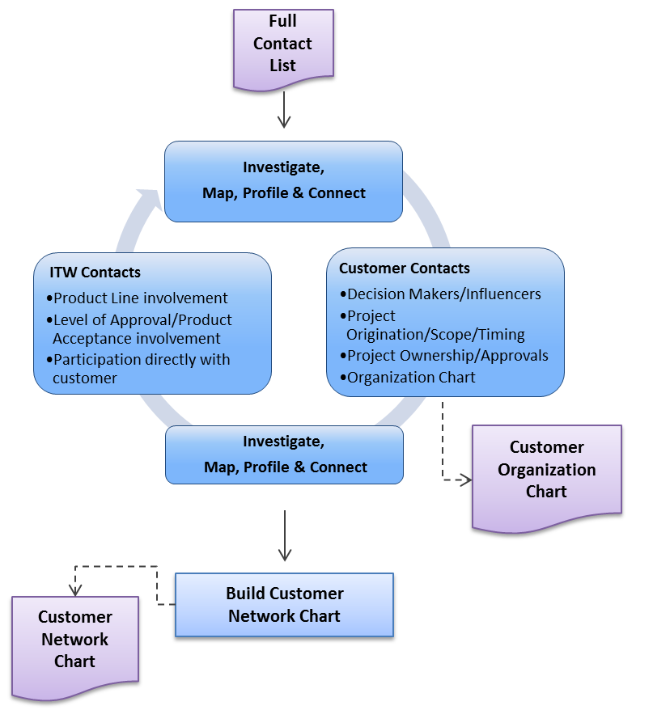
STEP 2.2: PROFILING OF THE CUSTOMER NETWORK
Step 2.2
PROFILING OF THE CUSTOMER NETWORK
Key Steps
Get prepared for a valuable Customer Meeting
(Meeting on site, Web Meeting, etc.)
2. Gather as much relevant information/facts about the Customer
Network as possible
Find the right balance between interesting information for
customer and questions regarding Customer Network
Build up Customer Network Chart with matches between ITW representatives and customer contact
Start collecting Buying Process related information
Key Points:
Avoid assumptions
Be clever with your investigation, and recruit others to help.
Be prepared with mapping and process questions (advance work), but make sure that it feels conversational.
Proprietary & Confidential. Not to be Disclosed or Used Outside of ITW
18
Notes:
Key Points:
Make sure audience is clear with the flow.
Be clever w/ your investigation, and recruit others to help populate the tool.
If preparing for a meeting (introductory or follow-up) be prepared with mapping questions in advance!
Be prepared with questions about their process, especially who plays a role, how are they predisposed, etc..

Slide 19
STEP 2.2: CHECKLIST
Activity | Responsible | Accountable | Consulted | Informed | TOOL / Best Practice
Profiling of the Customer network with ITW matches |  |  |  |  | STEP 2 Flowchart STEP 2 Checklist STEP 2 Relationship Management Tool
A - Integrate existing contact information in the Customer Network Chart Name Position Role Attitude | NAM | NAM | VP/GM / SDM / SERVICE | DIVISION PL / Eng / ACCOUNTING
B - Match ITW contacts with Account contacts Who talks with who & when?
C - Obtain and create an organization chart How is the company structured?
Proprietary & Confidential. Not to be Disclosed or Used Outside of ITW
19

Slide 20

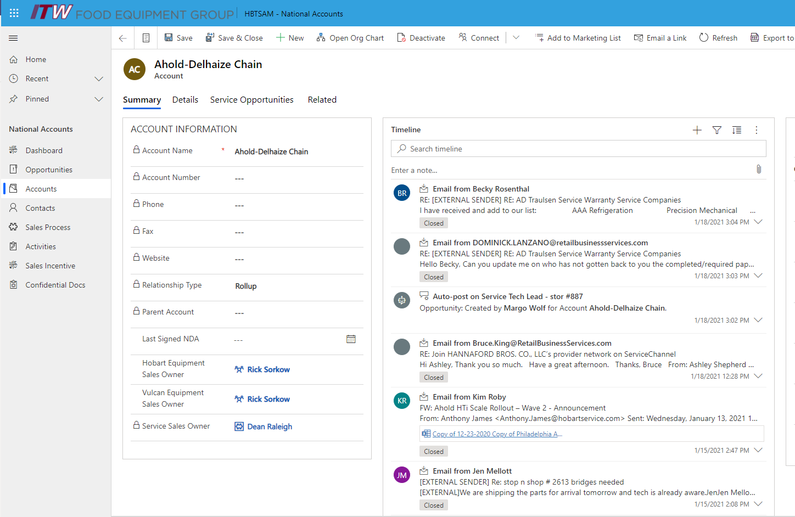
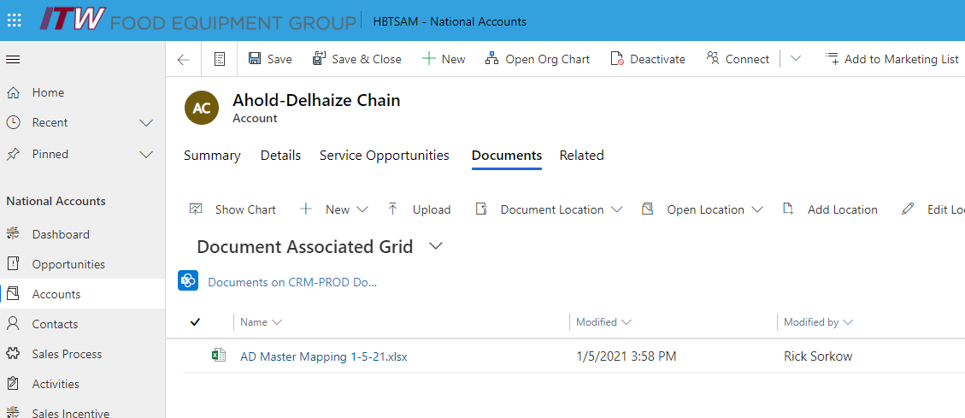
STEP 2.2: MAPPING EXAMPLE
From
Limited contact points
Limited understanding of application and goals
Limited opportunities to identify pain points
Limited opportunities to demonstrate value
Limited opportunities to adjust during test process
Purchase price focus
To
Proactive position w/ better understanding of needs
Better understanding of stakeholders and levers
Better position to target value proposition
Coordinated ITW approach w/ layers of relationship
Long-term Customer-Back benefits
Proprietary & Confidential. Not to be Disclosed or Used Outside of ITW
20
Notes:
Key Points:
This is an example of a mapping tool. You will hear more about this account later today. Our Retail and Foodservice NAMS have been populating tables like this in 2020.
Role, Attitude, and Influence are of highest importance.
ITW Contact Matrix is new with CSP and is of critical importance.
The point is to move away from the “From” list, where they key word is “Limited.” The “To” position provides better layers of relationship, better understanding of people and processes, and minimizes likelihood of gaps and misses.

Slide 21
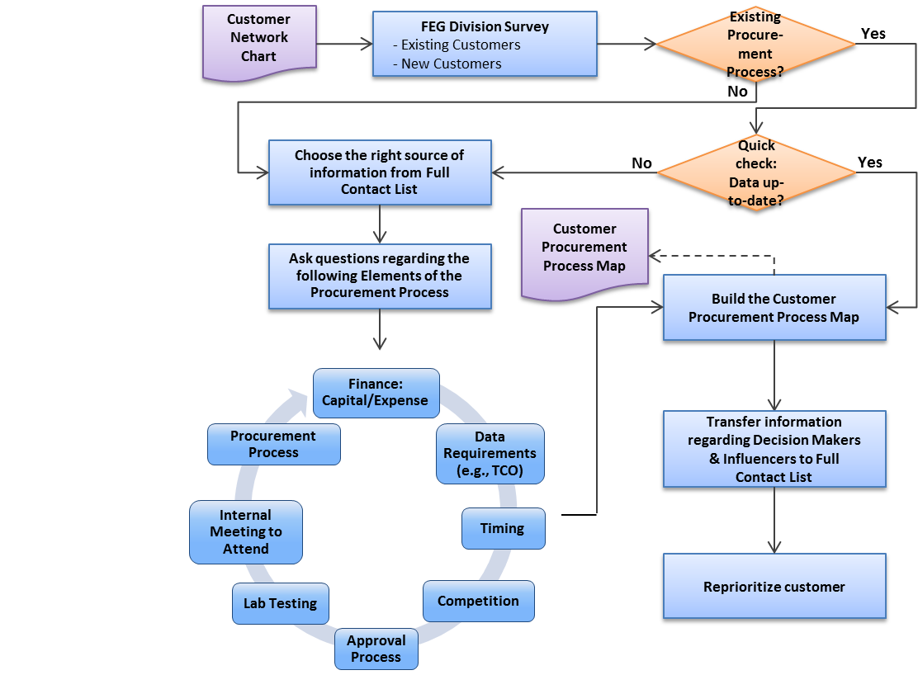
STEP 2.3: UNDERSTAND PROCUREMENT PROCESS
Step 2.3
UNDERSTAND PROCURMENT PROCESS
Key Steps
Gather information regarding customer Procurement Process from relevant sources (Survey/Investigation)
Build up the Customer Procurement Process Map over time
Transfer information regarding Decision Makers & Influencers to the Full Contact List from Step 2.1
Reprioritize customer in respect of the outlined Procurement Process to latest criteria from STEP1 if necessary
Key Points:
No assumptions based on history
Review with internal team to identify any potential gaps
Need to fully understand the customer Procurement Process
to go forward
Understand the timeframe of the customer to meet expectations
Proprietary & Confidential. Not to be Disclosed or Used Outside of ITW
21
Notes:
Key Points:
Make sure audience is clear with the flow.
Clarify “Choose the right source” comment. It is important to blend input from all available sources, and filter appropriately.
Emphasize “No assumptions based on history.” Chain business, influencers, and critical issues are very fluid. Assumptions can lead to complacency.

Slide 22
STEP 2.3: CHECKLIST
Activity | Responsible | Accountable | Consulted | Informed | TOOL / Best Practice
Identify process flow that outlines Key actions in the procurement process Individuals involved |  |  |  |  | STEP 2 Flowchart STEP 2 Checklist STEP 2 Relationship Management Tool
A - Possible questions to ask: What is the fiscal year end? Is this a corporate initiative/capex and what is the timeline for this opportunity? Is there a lab/store test involved prior to purchase? Will this opportunity be a sourcing event (RFP, Bid, etc.) or a separate negotiation? What are the stages of approval and who need to be involved with each step of the approval process? Is this a procurement purchase, facilities maintenance purchase or other? Are the processes the same for each group? Is this a centralized or de-centralized decision (e.g. corporate, regional, store level, etc.) What type of information or you or the decision makers expecting (e.g. TCO, history, references, pricing levels, etc.) Are there any vendors competing in the same business and why did ITW get selected? Are there any internal meetings that I can provide information or support you? Can I participate? Etc. | NAM | NAM | VP/GM / SDM / SERVICE | DIVISION PL / Eng / ACCOUNTING | Additional Questions List
Proprietary & Confidential. Not to be Disclosed or Used Outside of ITW
22

Slide 23
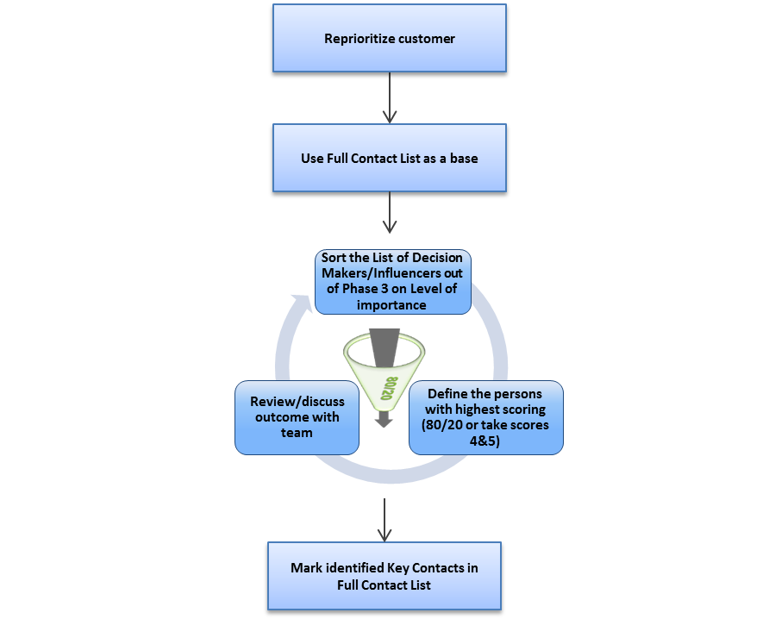
STEP 2.4: 80/20 FOCUSING
Step 2.4
80/20 FOCUSING
Key Steps
Sort the Full Contact List descending on level of importance
Define your individual 80/20-Filter criteria
Review identified 80 Key Contacts with team in order to make sure that “hidden 80 contacts” are included
Mark the identified Key Contacts in Full Contact List from Step 2.1 to go forward to Step 2.5
Key Points:
Don’t miss out someone by classifying as a 20 → Review
Use real data to ensure that we don‘t waste resources and time based on assumptions
Constantly update!
Proprietary & Confidential. Not to be Disclosed or Used Outside of ITW
23
Notes:
Key Points:
Make sure audience is clear with the flow.
- Constantly update!

Slide 24
STEP 2.4: CHECKLIST
Activity | Responsible | Accountable | Consulted | Informed | TOOL / Best Practice
Define the final list with Key Contacts |  |  |  |  | STEP 2 Flowchart STEP 2 Checklist STEP 2 Relationship Management Tool
A - 80/20-Filter applied on Full Contact List through following actions: Sort the Full Contact List descending on level of importance Mark persons with highest scoring Review and discuss outcome with team | NAM | NAM | VP/GM / SDM / SERVICE | DIVISION PL / Eng / ACCOUNTING
Proprietary & Confidential. Not to be Disclosed or Used Outside of ITW
24

Slide 25
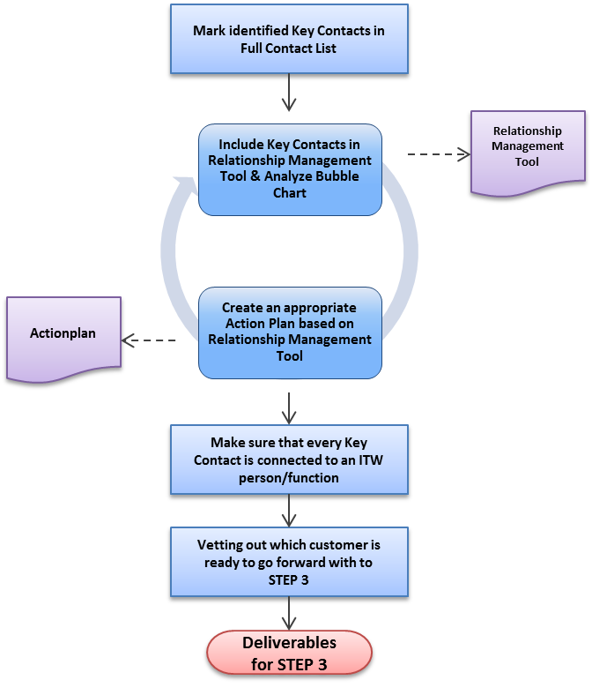
STEP 2.5: RELATIONSHIP MANAGEMENT ACTIONS
Step 2.5
RELATIONSHIP MANAGEMENT ACTIONS
Key Steps
Include Key Contacts in Relationship Management Tool
Analyze Bubble Chart: Strengthen pros, work on cons and neutrals
Match our team with customer contacts based on needs and existing relationships
Define actions for each of the 80 customer contacts, develop timeline of actions
Establish a tracker to follow the timely execution
Document next steps and actions on the key timeline
Final vetting out which customer is ready to go forward with to STEP 3 in respect of Procurement Process and identified contacts
Key Points:
Make sure everyone is involved – Don’t underestimate the importance of layered relationships.
Be accountable for the actions. It is not a recommendation. A proactive action plan is a required step.
Proprietary & Confidential. Not to be Disclosed or Used Outside of ITW
25
Notes:
Key Points:
Make sure audience is clear with the flow.
Don’t underestimate the importance of layers of relationship. It will help the NAM to cover gaps and help FEG to maximize genuine partnership.
Be accountable for the actions. It is not a best practice. A proactive action plan is a required step.

Slide 26
STEP 2.5: CHECKLIST
Activity | Responsible | Accountable | Consulted | Informed | TOOL / Best Practice
Set up defined Action Plan based on the Relationship Management Tool and identified gaps. |  |  |  |  | STEP 2 Flowchart STEP 2 Checklist STEP 2 Relationship Management Tool
A - Define specific objectives to improve Relationship: Plant Visit Customer visits on site Roadshow/demonstration of equipment Invitation to customer events & exhibitions Meeting with R&D or PM in order to explore the capability of the product Cross-selling: Organize contact information or meetings with related ITW units Make sure customer and ITW side is involved about the planned actions (proof of concept) | NAM | NAM | VP/GM / SDM / SERVICE | DIVISION PL / Eng / ACCOUNTING
Proprietary & Confidential. Not to be Disclosed or Used Outside of ITW
26

Slide 27
STEP 2: LEARNINGS
Responsible | Accountable | Consulted | Informed
NAM NAM NAM | NAM NAM NAM | VP/GM / SALES / SERVICE VP/GM / SDM / SERVICE VP/GM / SDM / SERVICE | DIVISION PL / Eng / ACCOUNTING DIVISION PL / Eng / ACCOUNTING DIVISION PL / Eng / ACCOUNTING
Step 2.1 Identify Contacts
Mapping the Customer is not that easy as it seems
  Quantity of information (information overload vs. information gap)
  Starting point with just one customer contact
Don’t limit the number of customer contacts for the process
Step 2.4 80/20 Focusing
Don’t limit your whole focus just on the “80” customer contacts. Be also aware of the “20”. Today’s “20” could become an “80” in the future
Step 2.5 Relationship Management Actions
Create an Action Plan with clear responsibilities and a realistic timeline. Set up a Follow Up System that ensures that the Action Plan is kept
General
Different standards of information and details as a result of FEG surveys
Stick to the Timeline – don’t get lost in details
Backflow of New Customer Contact information from following steps
→ Mapping the customer is an iterative process
Proprietary & Confidential. Not to be Disclosed or Used Outside of ITW
27

Slide 28
STEP 2 Key Takeaways
Clearly understanding who the gate keeper is within the organization. Who has the power for the final say.
Ensure that we have multiple contacts with an action plan for each person. Are there any individuals who could derail the project?
Is there a different buying and decision-making process for service? Can this impact product selections?
Consider the customer procurement process and fiscal year timing so not to lose out on an opportunity
Proprietary & Confidential. Not to be Disclosed or Used Outside of ITW
28

Slide 29
Concentrated Sales Process – Step 3
Concentrated / Key / Development Accounts
1. Segmentation & Customer Analysis
2. Mapping the Customer
3. Customize the Value Proposition
4. Setting the Plan to Win
5. Deploy & Follow Up
1.1 Identify
your ’80’ target sub-segments based on FTB data, external data for Market Growth Areas and product match-making (type of products we are selling to ’80’ accounts)
Develop criteria of a ‘good’ prospect in the market.
1.2 Evaluate
and filter the most attractive opportunities based on business criteria and thresholds
1.3 Prioritize
80’ customers/opportunities that will enable maximum focus on high potential opportunities (business impact, time/effort & resources/investments to implement)
2.1 Identify Contacts & Classification with different Roles
Sum up findings out of STEP 1 and set up timeline for the whole STEP 2. Identify and include all customer in a list.
2.2 Profiling of the Customer Network
Develop customer contact profile and assign customer classification. Connect customer contacts with ITW representatives.
2.3 Understand Customer Procurement Process
Identify customer Procurement process
2.4 80/20 Focusing
Selection of 80 customer contacts
2.5 Relationship-Management Actions
Set up an Action Plan for identified Key Contacts
3.1 Define customer’s needs, pain points & opportunities
3.2 Determine Product/Service Strategy
  Does current product or customized solution meet the needs or require an enhancement?
  Risk Assessment
3.3 Customize our Value Proposition
  Uptime
  Quantify lost sales,
  Impact to retailer
  Inventory
  Financial impact/Payback scenario
  Efficiency
  Safety
4.1 Product Testing
Understand, engage in, and execute the product testing phase
4.2 Finalization of Specification
Completely align w/ our customer on physical and performance specifications
4.3 Establish Pricing
4.4 Documented Commitment to Purchase
4.5 Deployment Strategy
Effectively execute a deployment strategy, and facilitate a transition to Step 5
5.1 Project Deployment
    Project Management
    Operations
    Supply
    Aftersales
5.2 Follow Up
    Inside – Out
    Quantitative Performance Tracking
    Financial validation
    Outside – In
    Qualitative Performance Tracking
    Internal & External Feedback
    Leverage Performance with Customer
SDM Led
Proprietary & Confidential. Not to be Disclosed or Used Outside of ITW
29

Slide 30
STEP 3: WHAT / WHY / DESIRED OUTCOMES
What
Why
Desired Outcomes
Step 3.1
Define customer’s needs, pain points & opportunities.
Step 3.2
Determine Product/Service Strategy:
  Does current product or customized solution meet the needs or require an enhancement?
  Risk Assessment
Step 3.3
Customize our Value Proposition:
  Uptime
  Quantify lost sales,
  Impact to retailer
  Inventory
  Financial impact/Payback scenario
  Efficiency
  Safety
To provide a compelling customer value proposition while driving profitable ITW growth thru differentiated products and full solutions.
Enterprise wide stakeholders understand opportunity and customer needs and ability to differentiate.
Method to find pain points that the customer may not know exist and provide better value proposition vs competition.
To ensure the solutions are valued by the customer and determine if resources required to achieve customer needs should be allocated
Provides clear view of “80” needs and pain points for the customer, is achievable, and the customer will pay.
An enterprise wide plan has been created, implemented and communicated to meet value proposition requirements.
Divisional financial metrics have been validated for the opportunity and the value proposition vs effort.
Value Proposition is realistic (fact based) and the customer believes in the proposal.
Clear understanding of the opportunity vs product changes and resources required to justify CEP.
30
Proprietary & Confidential. Not to be Disclosed or Used Outside of ITW
30

Slide 31
STEP 3.1: CHECKLIST
Activity | Responsible | Accountable | Consulted | Informed | TOOL / Best Practice
Define Customer’s Needs | SDM / NAM | SDM | VP KA / Engineering | Marketing / Service | Interview/Observation Guide
Confirm the team members
Create Interview/Observation guide for site visits
Check if NDA required to visit locations
Schedule interviews and locations to observe
Check with Service for existing contracts, relationships
Summarize findings and prioritize pain points
Vet preliminary findings with the customer
Determine if project moves forward
Proprietary & Confidential. Not to be Disclosed or Used Outside of ITW
31

Slide 32
STEP 3.2: CHECKLIST
Activity | Responsible | Accountable | Consulted | Informed | TOOL / Best Practice
Determine Strategy | SDM / NAM / Engineering / Service | SDM | VP/GM / VP KA | Marketing | Risk Assessment Form
Identify solutions to pain points
Does the product line and Service have existing solutions
Outline gaps in current product/service offering
Define all aspects of the solution
Start Risk Assessment
Summarize findings and prioritize pain points
Complete financial review of project feasibility
Proprietary & Confidential. Not to be Disclosed or Used Outside of ITW
32

Slide 33
STEP 3.3: CHECKLIST
Activity | Responsible | Accountable | Consulted | Informed | TOOL / Best Practice
Customize Value proposition | SDM / NAM | SDM | VP KA / Service | Marketing / Engineering | Value Proposition Tool, TCO Example, Marketing Requirements Document
Quantify the current customer and competitive cost of ownership
Assess FEG solution to competition
Create and validate our new proposed value proposition
Customer approval of the value prop
Update Risk Assessment
Budgetary pricing supported by ITW margin expectations
Customer Acceptance of Value Proposition and TCO
Complete Product Requirements Document
Proprietary & Confidential. Not to be Disclosed or Used Outside of ITW
33

Slide 34
STEP 3: LEARNINGS
Responsible | Accountable | Consulted | Informed
SDM / NAM SDM / NAM / Engineering / Service SDM / NAM | SDM SDM SDM | VP KA / Engineering VP/GM / VP KA VP KA / Service | Marketing / Service Marketing Marketing / Engineering
Step 3.1 Define Customer Needs
Don’t assume you know what the customer needs. Spend time observing operations.
Gain credibility with the customer, we are the experts
Look for work arounds at the customer location. These are soft benefits to differentiate
Prioritize pain points, which require highest focus
Step 3.2 Determine Product/Service Strategy
If changes are required to ‘80’ products, consult operations to minimize impact to the production
Consider the difficulty to meet the customer spec. What can be done to simplify.
Project risk assessment must be completed by all parties (engineering, operations, service, etc.)
Gather feedback from key customer stakeholders, their feedback will help shape program
Step 3.3 Customize our Value Proposition
Ensure that the value proposition we are presenting can be verified with facts and addresses key customer pain points
Quantify competitive offerings, check against our value proposition
Consider competitive reaction, what should we be prepared for with our value proposition
Finalize pricing scenarios considering value proposition and payback for the customer
Ensure that material costs are correct when calculating margins. Must meet ITW expectations
If value proposition isn’t significant, repeat phase B for additional work
Proprietary & Confidential. Not to be Disclosed or Used Outside of ITW
34

Slide 35
STEP 3 Key Takeaways
Cross functional team needs to spend time with the customer and on site to truly understand pain points and opportunities. This is a good opportunity to become the expert in the customers view and they come to us for support and questions.
Consider the risk to making design changes to ‘80’ products or services. Do we understand the performance risks and potential issues. Could this impact others within FEG if we make a mistake
Ensure the value proposition is 100% accurate, must be proven
Proprietary & Confidential. Not to be Disclosed or Used Outside of ITW
35

Slide 36
Concentrated Sales Process – Step 4
Concentrated / Key / Development Accounts
1. Segmentation & Customer Analysis
2. Mapping the Customer
3. Customize the Value Proposition
4. Setting the Plan to Win
5. Deploy & Follow Up
1.1 Identify
your ’80’ target sub-segments based on FTB data, external data for Market Growth Areas and product match-making (type of products we are selling to ’80’ accounts)
Develop criteria of a ‘good’ prospect in the market.
1.2 Evaluate
and filter the most attractive opportunities based on business criteria and thresholds
1.3 Prioritize
80’ customers/opportunities that will enable maximum focus on high potential opportunities (business impact, time/effort & resources/investments to implement)
2.1 Identify Contacts & Classification with different Roles
Sum up findings out of STEP 1 and set up timeline for the whole STEP 2. Identify and include all customer in a list.
2.2 Profiling of the Customer Network
Develop customer contact profile and assign customer classification. Connect customer contacts with ITW representatives.
2.3 Understand Customer Procurement Process
Identify customer Procurement process
2.4 80/20 Focusing
Selection of 80 customer contacts
2.5 Relationship-Management Actions
Set up an Action Plan for identified Key Contacts
3.1 Define customer’s needs, pain points & opportunities
3.2 Determine Product/Service Strategy
  Does current product or customized solution meet the needs or require an enhancement?
  Risk Assessment
3.3 Customize our Value Proposition
  Uptime
  Quantify lost sales,
  Impact to retailer
  Inventory
  Financial impact/Payback scenario
  Efficiency
  Safety
4.1 Product Testing
Understand, engage in, and execute the product testing phase
4.2 Finalization of Specification
Completely align w/ our customer on physical and performance specifications
4.3 Establish Pricing
4.4 Documented Commitment to Purchase
4.5 Deployment Strategy
Effectively execute a deployment strategy, and facilitate a transition to Step 5
5.1 Project Deployment
    Project Management
    Operations
    Supply
    Aftersales
5.2 Follow Up
    Inside – Out
    Quantitative Performance Tracking
    Financial validation
    Outside – In
    Qualitative Performance Tracking
    Internal & External Feedback
    Leverage Performance with Customer
SDM Led
Proprietary & Confidential. Not to be Disclosed or Used Outside of ITW
36

Slide 37
STEP 4: WHAT / WHY / DESIRED OUTCOMES
What
Why
Desired Outcomes
Step 4.1
Product Testing
Understand, engage in, and execute the product testing phase
Step 4.2
Finalization of Specification
Completely align w/ our customer on physical and performance specifications
Step 4.3
Establish Pricing
Step 4.4
Documented Commitment to Purchase
Step 4.5
Deployment Strategy
Effectively execute a deployment strategy, and facilitate a transition to Step 5
Product testing and approval process vary widely from chain to chain. It is in our best interest to attempt to control, or at least define, all testing parameters and the testing protocol.
It is our responsibility to make sure that we are in complete agreement with the end user customer on the physical and performance specification of the equipment. We must also understand the opportunity and/or expectations for services.
There are several important factors that go into how to price our equipment for a chain opportunity. All considerations must be understood.
If we understand and have effectively been engaged in the testing program, we should be well-positioned and well-prepared to influence the termination of testing, and to make our final case.
Actual deployment takes place in Step 5, but within step 4 we have the responsibility to make sure that best plans are in place for greatest impact.
We have successfully tested our equipment in a way that meets our customer’s and our expectations. We have a complete understanding of the demands and application, and we have positioned ourselves well to confirm specifications.
An agreement has been reached between ITW and our end-user customer on the performance specifications of our equipment and of any services that will be provided.
Internal pricing models (see Step 3) have been polished, and our strategy is created. Channel pricing is derived from the balanced understanding of internal targets and customer/volume influences.
We know where we stand, and we have a commitment to purchase.
We have developed a sound deployment strategy, with plans for a clean transition to Step 5.
37
Proprietary & Confidential. Not to be Disclosed or Used Outside of ITW
37

Slide 38
STEP 4.1: CHECKLIST
 | *RACI is very situational. Those listed have potential to be involved, but are not always involved.
Activity | Responsible | Accountable | Consulted | Informed | TOOL / Best Practice
Product testing and approval process can vary widely from chain to chain. It is in our best interest to attempt to control, or at least define, all testing parameters and the testing process. Examples include, but are not limited to: | SDM / NAM / Engineering / Installation Team / End User | SDM | VP Sales / BU Marketing / Quality Control / Service Products / Legal / Dealer / FRED / Consultant | SVP Sales / Manufacturing / Group President / VP/GM / Service VP / Service RD / ITW EVP / FEG Controller
Prior to providing any confidential information, confirm we have an executed NDA. If there is not one in place, consider using the template provided here. |  |  |  |  | Non-Disclosure Agreement
Determine who is responsible for test equipment.
Establish with the customer a clear understanding of performance expectations, including definition of success or failure.
Understand the competitive nature of the test (just us, or multiple brands being considered.
Confirm a clear understanding of duration of test.
Confirm that a clear plan is in place for operator/evaluator training.
Establish a clear understanding of methods and cadence of communication and feedback.
We have a plan for test equipment disposition.
We understand subsequent steps of testing protocol (assuming first test is at chain HQ): Test unit at one store -- Test unit at two stores -- Test unit at X stores -- Testing by region, etc. In foodservice channel, dealer or franchisee may play a role.
Confirm that we have obtained an executed field test agreement which stipulates the terms of the field test. If there is not one in place, consider using the template provided here. |  |  |  |  | Field Test Agreement
Proprietary & Confidential. Not to be Disclosed or Used Outside of ITW
38

Slide 39
STEP 4.2: CHECKLIST
 | *RACI is very situational. Those listed have potential to be involved, but are not always involved.
Activity | Responsible | Accountable | Consulted | Informed | TOOL / Best Practice
It is our responsibility to make sure that we are in complete agreement with the end user customer on the physical and performance specification of the equipment. In addition to equipment specifications, we must also understand the opportunity and/or expectation for services -- including, but not limited to: Installation, warranty (normal or extended), and/or additional service products: | SDM / NAM / Engineering / Service Products / Installation Team | SDM | BU Marketing / Quality Control / Legal | SVP Sales / VP Sales / VP/GM / Manufacturing / Purchasing / ITW EVP / FEG Controller
Does equipment from Step 3 meet expectations? If we are developing any new intellectual property for the customer, consult Legal and first negotiate a JDA.
If installation is a part of the opportunity, all details and responsibilities are understood. Who receives equipment? Who is responsible for trades (electrical, plumbing, fabrication, etc.), ITW or other? Are the installation terms in the Master Purchase Agreement?
All equipment training needs have been identified.
For warranties, PMs, or enhanced Service offerings, all expectations are understood. To the extent that any warranty language is included in the specification and no Master Purchase Agreement is in place, have Legal review warranty and PO language.
Proprietary & Confidential. Not to be Disclosed or Used Outside of ITW
39

Slide 40
STEP 4.3: CHECKLIST
 | *RACI is very situational. Those listed have potential to be involved, but are not always involved.
Activity | Responsible | Accountable | Consulted | Informed | TOOL / Best Practice
There are several important factors that go into how to price our equipment for a chain opportunity. Below list includes many of the questions that should be answered in advance of a proposal. For volume opportunities, it is in our best interest (albeit sometimes difficult) to have firm commitments from our customer on quantities, and over what period of time: | SDM / NAM / Service Products / Installation Team / Dealer / FRED / End User | SDM | VP Sales / SAM Controller / SAM Credit / VP/GM / BU Controller / BU Marketing / Purchasing / Service VP / Legal | SVP Sales / Customer Care / Group President / ITW EVP / FEG Controller
Have we proposed using our Master Purchasing Agreement, a template of which is provided here. If customer insists on using their form, have Legal review. While the pricing terms are being negotiated, legal terms should be negotiated in tandem. |  |  |  |  | Master Purchase Agreement
Establish a clear understanding of the competitive situation for this opportunity.
We have agreed with the customer on any other (non-equipment) services or expectations, including but not limited to: Installation, delivery, demonstration, operator training, operational videos, equipment start-ups, extended warranties, PM programs, enhanced service offerings, etc..
Confirm is a dealer involved, or not (mainly foodservice). If yes, we understand if the arrangement between the chain, dealer, and manufacturer is open book or discrete. If yes, we understand if the dealer is eligible to earn rebate. If yes, we understand fi the buying group is eligible to earn rebate.
Confirm with the end user the duration of the approved pricing.
We have an agreement with the end user on the anticipated quantity, build schedule, shipment schedule, etc..
Confirm with the end user the payment terms.
We have considered with the end user (and made arrangements for, if applicable) any program for or value towards buy-back or trade-in equipment, including any recycling opportunities.
We have an alignment with internal stakeholders on our pricing position vs ITW margin targets.
Proprietary & Confidential. Not to be Disclosed or Used Outside of ITW
40

Slide 41
STEP 4.4: CHECKLIST
 | *RACI is very situational. Those listed have potential to be involved, but are not always involved.
Activity | Responsible | Accountable | Consulted | Informed | TOOL / Best Practice
If we understand and have effectively been engaged in the testing program, we should be well-positioned and well-prepared to influence the termination of testing, and to make our final case: | SDM / NAM / Service Products / Installation Team / Dealer / FRED | SDM | VP Sales / BU Marketing | SVP Sales / Group President / VP/GM / Engineering / Manufacturing / ITW EVP / FEG Controller / Legal
We have finalized our negotiation preparations. A template of the negotiation pre-work is available here. |  |  |  |  | Negotiation Worksheet
We have secured with the customer a time and place to review test results, present final offer, and next steps.
Confirm all key ITW internal stakeholders are aligned.
Negotiate Master Purchase Agreement commercial terms, such as pricing payment terms, warranty, service, installation, etc.
We deliver a refined and compelling story that includes all key components from Step 3 (Customizing the Value Proposition), our testing experience, and our pricing strategy.
We know where we stand.
Finalize negotiations and execute Master Purchase Agreement.
Proprietary & Confidential. Not to be Disclosed or Used Outside of ITW
41

Slide 42
STEP 4.5: CHECKLIST
 | *RACI is very situational. Those listed have potential to be involved, but are not always involved.
Activity | Responsible | Accountable | Consulted | Informed | TOOL / Best Practice
Actual deployment takes place in Step 5 (Execute and Follow Up), but within Step 4 we need to have considered: | SDM / NAM / Manufacturing / Installation Team / Service Products / End User / Dealer / FRED | SDM | VP Sales / VP/GM / BU Marketing / Purchasing / Service VP / End User / Dealer / FRED | SVP Sales / Customer Care / Group President / Engineering / Quality Control / Service RD / Service Parts / ITW EVP / FEG Controller / Legal / End User / Dealer / FRED
We understand if this initiative is system-wide or predominantly corporate (for foodservice).
If system-wide, we understand if it is required for franchisees, or optional.
If system-wide, we understand what level of influence the chain/corporation has.
If system-wide, we understand what level of influence the dealer(s) have.
If system-wide, and optional for franchisees, we have a plan in place for next level selling.
We have received the Purchase Order
Proprietary & Confidential. Not to be Disclosed or Used Outside of ITW
42

Slide 43
STEP 4: LEARNINGS
Responsible | Accountable | Consulted | Informed
SDM / NAM SDM / NAM / Installation SDM / NAM / Dealer / End User SDM / NAM / Dealer SDM / NAM / Manufacturing / Installation / End User / Dealer | SDM SDM SDM SDM SDM | Dealer VP Sales / BU Marketing VP Sales / VP/GM / Purchasing / End User / Dealer | Dealer Customer Care VP/GM / Manufacturing Customer Care / Engineering / Quality Control / End User / Dealer / FRED
Step 4.1 Product Testing
Do your best to resist just sending a piece of equipment, without understanding of testing protocol. Even if customer won’t complete a field test agreement, still use it as an opportunity to ask as many questions as you can. We deserve to have some answers about test procedures, measurement, etc.
Step 4.2 Finalization of Spec
Make sure that it is clearly documented what the precise expectations/specifications are for the performance and application of our equipment. Along with that, make sure that it is clearly understood who is doing what, for any part of the opportunity, and you are aligned with your customer on service expectations.
Step 4.3 Establish Pricing
Don’t forget to understand what role the dealer and/or buying group will have in the transaction, and make sure you understand pricing responsibilities for each party.
Get the best possible assessment of the volume of the opportunity but be sure to understand if/how the franchisees will be expected to participate.
In pricing model ensure Service question is being asked.
Step 4.4 Commitment to Purchase
The entire point of 4.4 is bundling up all of the activity that has so-far taken place into a formalized offer, getting a commitment, and knowing where you stand. Watch-out, especially here, because this is where projects have the greatest potential to linger without clear next steps or action items.
Step 4.5 Deployment Strategy
Details, details, details… This is where you will hand all of the work that has been planned for over to manufacturing and service for the work to begin. Make sure that your quantities, build schedules, shipment schedules, etc. are as precise as can be.
Get the order! There is nothing to deploy without the order from the customer.
Proprietary & Confidential. Not to be Disclosed or Used Outside of ITW
43

Slide 44
STEP 4 Key Takeaways
Be sure to understand/engage in all parameters and protocol around equipment testing, including, but not limited to:
  Set clear expectations for performance testing at the customer - Identify any gaps in machine performance and comparison to competitive equipment
  Duration of test - clarify next steps after test
  Develop relationships with the operators and support training - routinely check-in to verify positive experience
  Look for additional soft benefits from the operators
When establishing final pricing proposals for chain opportunities, be sure to have investigated:
  Competitive positions
  Dealer involvement
  Rebate impact
  Service elements – install pricing, start-ups, contract programs
  All balanced w/ ITW margin expectations
Secure the best level of commitment of volume vs time, as the volume (opportunity) is often misrepresented.
Contract negotiations can take significant time. Identify any roadblocks early in the process
Make sure the “back of the house” is ready – could mean purchasing, manufacturing, quality, customer care, finance, service, or most likely, some combination of all
Know where you stand, and if all has progressed satisfactorily, press for progress/movement
Proprietary & Confidential. Not to be Disclosed or Used Outside of ITW
44

Slide 45
Concentrated Sales Process – Step 5
Concentrated / Key / Development Accounts
1. Segmentation & Customer Analysis
2. Mapping the Customer
3. Customize the Value Proposition
4. Setting the Plan to Win
5. Deploy & Follow Up
1.1 Identify
your ’80’ target sub-segments based on FTB data, external data for Market Growth Areas and product match-making (type of products we are selling to ’80’ accounts)
Develop criteria of a ‘good’ prospect in the market.
1.2 Evaluate
and filter the most attractive opportunities based on business criteria and thresholds
1.3 Prioritize
80’ customers/opportunities that will enable maximum focus on high potential opportunities (business impact, time/effort & resources/investments to implement)
2.1 Identify Contacts & Classification with different Roles
Sum up findings out of STEP 1 and set up timeline for the whole STEP 2. Identify and include all customer in a list.
2.2 Profiling of the Customer Network
Develop customer contact profile and assign customer classification. Connect customer contacts with ITW representatives.
2.3 Understand Customer Procurement Process
Identify customer Procurement process
2.4 80/20 Focusing
Selection of 80 customer contacts
2.5 Relationship-Management Actions
Set up an Action Plan for identified Key Contacts
3.1 Define customer’s needs, pain points & opportunities
3.2 Determine Product/Service Strategy
  Does current product or customized solution meet the needs or require an enhancement?
  Risk Assessment
3.3 Customize our Value Proposition
  Uptime
  Quantify lost sales,
  Impact to retailer
  Inventory
  Financial impact/Payback scenario
  Efficiency
  Safety
4.1 Product Testing
Understand, engage in, and execute the product testing phase
4.2 Finalization of Specification
Completely align w/ our customer on physical and performance specifications
4.3 Establish Pricing
4.4 Documented Commitment to Purchase
4.5 Deployment Strategy
Effectively execute a deployment strategy, and facilitate a transition to Step 5
5.1 Project Deployment
    Project Management
    Operations
    Supply
    Aftersales
5.2 Follow Up
    Inside – Out
    Quantitative Performance Tracking
    Financial validation
    Outside – In
    Qualitative Performance Tracking
    Internal & External Feedback
    Leverage Performance with Customer
NAM Led
Proprietary & Confidential. Not to be Disclosed or Used Outside of ITW
45

Slide 46
STEP 5: WHAT / WHY / DESIRED OUTCOMES
What
Why
Desired Outcomes
5.1 Project Deployment
    Project Management
    Operations
    Supply
    Aftersales
5.2 Follow Up
    Inside – Out
    Quantitative Performance Tracking
    Financial validation
    Outside – In
    Qualitative Performance Tracking
    Internal & External Feedback
    Leverage Performance with Customer
Ensure successful delivery on the commitments made in steps 1 – 4 through organization wide stakeholder engagement.
Creation of new products that address unmet operational requirements and reduce the effectiveness of competitors.
Ensure we are delivering customer expectations through the deployment process and contract duration.
A long standing mutually profitable relationship with the customer aligned to the competencies of ITW.
Protect the long term profitability of ITW through differentiated products and services.
Delivering and maintaining the value proposition in line with the target financial and customer retention metrics.
Proprietary & Confidential. Not to be Disclosed or Used Outside of ITW
46

Slide 47
STEP 5.1: CHECKLIST
Activity | Responsible | Accountable | Consulted | Informed
Project Management Confirm project leader and cross-functional team Identify primary operational risks and mitigation plan Identify key internal & external training needs, KPIs and reporting process Drive all stakeholder responsibilities and communications Manage regular cross-functional engagement with the customer’s project team Ensure contractual requirements are clearly communicated. | NAM or Appointed Project Manager | NAM | Project Team Lead customer contact, representative and/or FEG Distributor Project Team
Operations (refer to detailed operations checklist) Is a CEP process involved and is the stage gate process complete Have all differentiated product elements been communicated through all disciplines Are capacity requirements clearly understood Are there adequate materials and labour provision to meet customer’s timelines | Appointed Operations project lead | NAM | Project Team
Supply (refer to detailed supply checklist) Are the supply requirements within our current capabilities Have all differentiated supply elements been communicated through all disciplines | Appointed Supply project lead | NAM | Project Team
Aftersales (refer to detailed aftersales checklist) Have all differentiated service elements been communicated through all disciplines Are warranty terms and aftersales service requirements understood across all territories | Appointed Aftersales project lead | NAM | Project Team
Proprietary & Confidential. Not to be Disclosed or Used Outside of ITW
47

Slide 48
STEP 5.2: CHECKLIST
Activity | Responsible | Accountable | Consulted | Informed
Inside Out Data Analysis Establish key inside out data requirements to give early indication of performance. Including (but not limited to:) | Customer Care Team / NAM | NAM | Project Team | Project Team
Short term feedback (0-30 days) On time delivery % Install completion Customer reject % CEP failure correction response time | Customer Care Team / NAM | NAM | Project Team | Project Team
Mid term feedback (30 days +) On time delivery % Customer reject % CEP failure correction response time Warranty failure % Average response time First call completion % Average time to complete repair Call back % Avoidable calls | Customer Care Team / NAM | NAM | Project Team | Project Team
Financial evaluation of project Validate against original revenue, margin and volume projections | Finance team / NAM | NAM | Project Team | GM
Proprietary & Confidential. Not to be Disclosed or Used Outside of ITW
48

Slide 49
STEP 5.2: CHECKLIST
Activity | Responsible | Accountable | Consulted | Informed
Outside-In Data Customer Feedback Short Term customer feedback during initial supply phase (1-5 days post supply or in response to an action) Mid Term Customer Feedback on equipment use/service (30 days +) | Customer Care Team / NAM | NAM | Project Team | Project Team
Validation of Value Proposition Review Project Goals, Objectives & Commitments, products and services delivered Face to face interviews with key stakeholders (ref: Steps 3&4) | NAM | NAM | Project Team | Project Team
Activity | Responsible | Accountable | Consulted | Informed
Lessons learned from inside-out and outside-in Follow Up Process Deploy lessons learned tool (P. Storitz under construction) Share customer feedback with internal project teams Leverage continuous improvement from short and medium term customer feedback Evaluate the relationship with the mid/long term 80/20 goals | NAM or Appointed Project Manager | NAM | Project Team | Project Team
Develop Dashboard for Delivering feedback to Key Customer stakeholders Report on short and medium term customer feedback (taking credit for successful execution) Investigate feedback from value proposition review Develop future negotiation standpoint Assess the alignment with customers own Service Management and KPI dash-boarding systems | NAM | NAM | Project Team | Project Team
Proprietary & Confidential. Not to be Disclosed or Used Outside of ITW
49

Slide 50
STEP 5: LEARNINGS
Responsible | Accountable | Consulted | Informed
NAM or appointed Project Manager / BU Leadership NAM or appointed Project Manager NAM & Engineering Team Customer Care Team / NAM | NAM NAM NAM NAM | Project Team Project Team Project Team | Project Team Project Team Project Team Project Team
Step 5.1 Project Management
Identify a project leader with skillsets relevant to the specific project
Establish cross functional teams early with specific knowledge in the organisations for:
  Commercials / Legal’s / risk management
  Operations – manufacturing / sourcing / planning
  Logistics – services / partner capabilities
  Aftermarket – service / warranty / support capabilities / connectivity / consumables
Project Manager
Be prepared to engage the project team direct with the customers project team and support customer internal champions / stakeholders
Don’t underestimate the demands of project management – “these projects are normally in addition to the day job”
Ensure resources are available to deploy the project
There can be difficulty in aligning our internal business units with needs of different geographical regions
CEP
Including CEP element supports the value proposition but requires detailed customer management. CEP processes add complexity into what is generally a narrow timeline
Step 5.2 Manage the Customer
Make the effort to validate customer data. Always assume customer information needs validating.
Maintain close stakeholder communications
Customer often delay actual PO due to internal sign off – needed to manage the customer to prevent timeline compression
Be responsive to changing customer values and needs
Proprietary & Confidential. Not to be Disclosed or Used Outside of ITW
50

Slide 51
STEP 5: KEY TAKEAWAYS
Importance of Project Management (Critical for Roll outs/larger contracts – coordination of our functional requirements & customer requirements on an ongoing basis – managing changes, customer expectations & problems that inevitably happen - helps deliver good execution & high levels of customer satisfaction & engagement
Understanding our performance with the Customer (usually an 80 customer) & understanding the Customers perception of our performance – First level - inside out data but we need Second level - outside in data from the Customer (Why wouldn’t we want this from our most important customers?)
  Inside Out data – On time delivery, rejects, warranty etc although a differentiator – can be considered table stakes by Customers
  Outside In data – Qualitative information – often perceived added value areas that can provide clear competitive & negotiation advantages or potential disadvantages – scope of capability, do what we say, consistent performance, easy to work with, flexible approach etc.
Proprietary & Confidential. Not to be Disclosed or Used Outside of ITW
51

